Slide 1
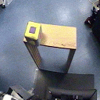
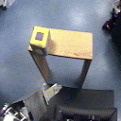
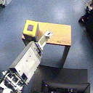
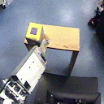
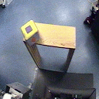
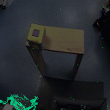
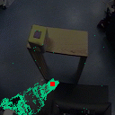
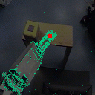
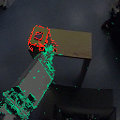
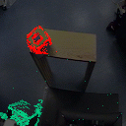

Slide 2
Edges of table and cube overlap
Color of cube and table are poorly separated
Cube has misleading surface pattern

Slide 3
Edges of table and cube overlap
Color of cube and table are poorly separated
Cube has misleading surface pattern

Slide 6

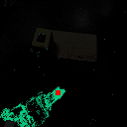
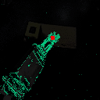
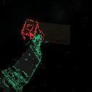
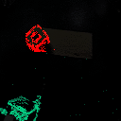
Begin
Find hand
Sweep
Contact!
Withdraw

Slide 7
X translation
Y translation
Translation
in depth
In-plane
rotation
Rotations
in depth
4 DOFs are trackable through projected appearance
2 DOFs remain:
point on surface

Slide 10
shoulder (a)
shoulder (b)
elbow (a)
elbow (b)
wrist (a)
wrist (b)

Slide 11
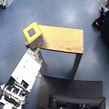
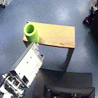
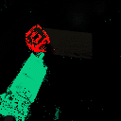
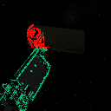

Slide 12
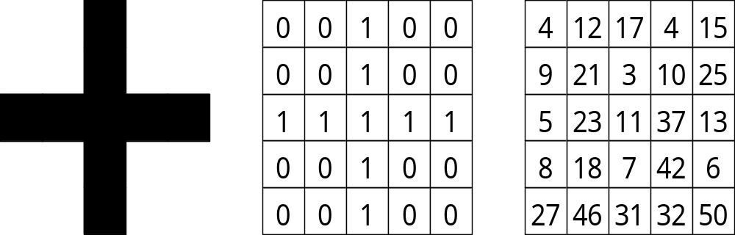
A cross
A binary cross
??

Slide 13
0
0
1
0
0
4
12
17
4
15
0
0
1
0
0
9
21
3
10
25
1
1
1
1
1
5
23
11
37
13
0
0
1
0
0
8
18
7
42
6
0
0
1
0
0
27
46
31
32
50
a cross
a binary cross
?

Slide 14
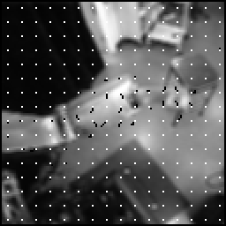
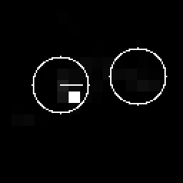
Optical flow
Maximum
Segmented regions

Slide 15
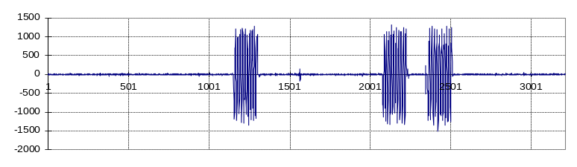
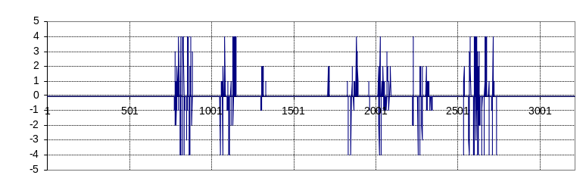
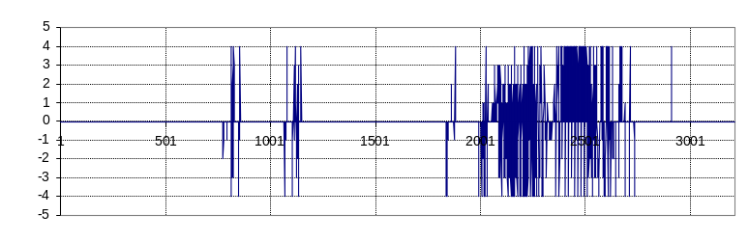
Joint speed (wrist)
Block (12,7)
optic flow (uncorrelated)
Block (10,5)
optic flow (correlated)

Slide 16
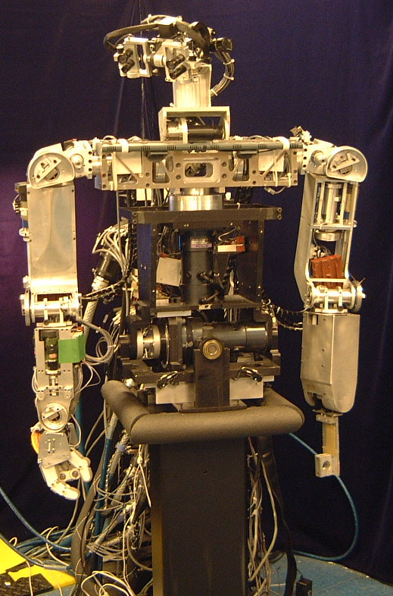
Head
(7 DOFs)
Right arm
(6 DOFs)
Left arm
(6 DOFs)
Torso
(3 DOFs)
Stand
(0 DOFs)

Slide 17
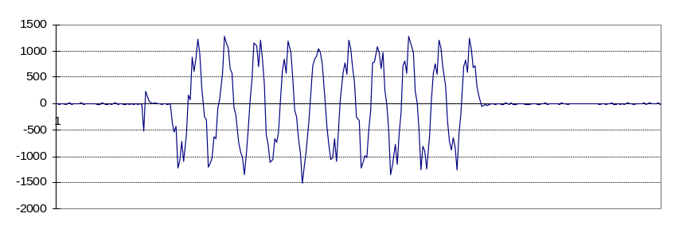
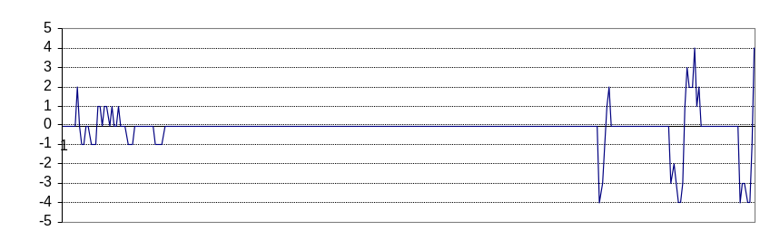
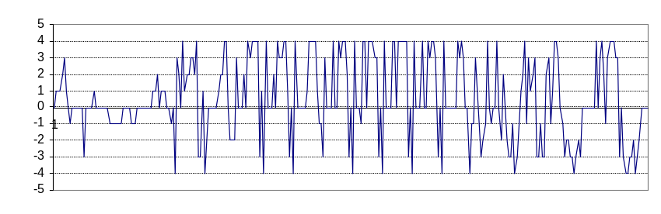
Joint speed (wrist)
Block (12,7)
optic flow (uncorrelated)
Block (10,5)
optic flow (correlated)

Slide 19
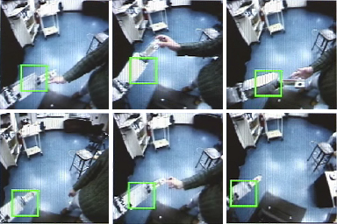

Slide 20
7
redundancy
reduction
gaze direction
head joint
position
2
map
2
image plane
position
4
arm joint
position

Slide 21
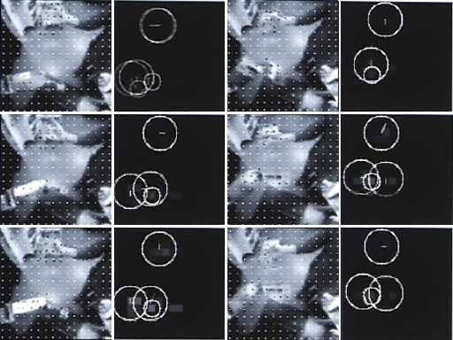

Slide 23
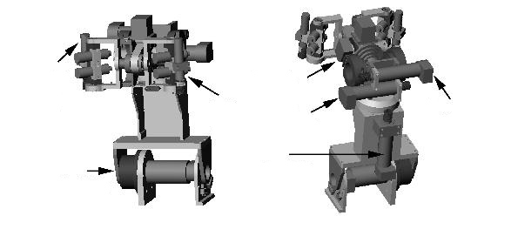
right
eye
pan
left
eye
pan
eye tilt
bottom
differential
top
differential
neck
tilt
neck
pan

Slide 26
X translation
Y translation
Translation
in depth
In-plane
rotation
Tangent region shifts when head rotates in depth

